Slide 1
Python programming
unit B3 – clustering

Slide 2
Clustering
Data clustering does not have a specific target. It is used to try to find the internal pattern of those data. Based on sample data characteristics of itself, the intrinsic patterns, clustering algorithms try to separate them into different groups.
For most of the case we can group data in the natural ways, like if data is person related, group in gender, age, cities or location, etc. for business data can group in industries, countries, regions, etc.
But there are also cases that all sample record no obvious way to separate. To study the patterns of the data is the only way.
General rules for data clustering:
Small distance for intra-cluster sample points
Large distance for inter-cluster sample points

Slide 3
K-means
Objective: minimize the sum of distances between the points and their respective cluster centroid.
Decide how many clusters, say k
Randomly choose k point from whole sample, as centroids
Cluster all samples to different cluster based their distances
For each cluster find a new centroid which minimize intra-cluster distance
Repeat 3 and 4, until no more change of the centroid points.
Because different feature (column data) may have different magnitude in numeric value, so need scale them before doing distance calculation.
Scipy.stats and Scikit-learn has k-means algorithms.

Slide 4
Hierarchical clustering
Agglomerative Hierarchical Clustering.
Each point belongs to it’s own cluster, means each cluster only one point.
Merge the closest 2 clusters into 1 cluster.
Repeat step 2, until all merged into one complete cluster.
Divisive Hierarchical Clustering
All points belong to one cluster.
Start with two farthest points in one cluster, to separate that cluster into 2 clusters.
Repeat step 2, until all clusters only one points.
Scipy.stats and Scikit-learn has hierarchical clustering algorithms.

Slide 5
practice
Using the WHO data we done in last class, as a dataset to use it do k-means clustering.
Download mall customer dataset, use it do hierarchical clustering.
https://www.kaggle.com/vjchoudhary7/customer-segmentation-tutorial-in-python

Slide 6
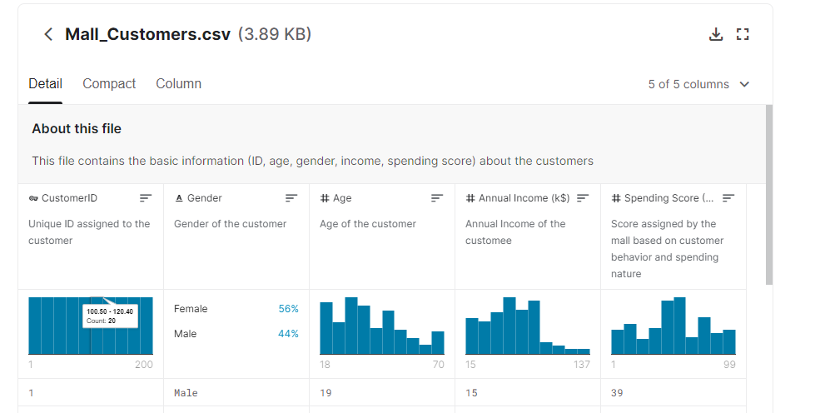
tasks
Mall customer data (customer segmentation)
https://www.kaggle.com/vjchoudhary7/customer-segmentation-tutorial-in-python
Use the mall customer dataset, try it using clustering method, and study customer segmentation

